Slide 1
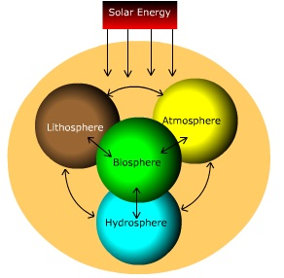
EARTH SUBSYSTEMS

Slide 2
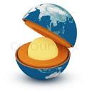
GEOSPHERE
The geosphere is the solid part of the Earth. Part of the geosphere is under the oceans, forming the seabed and forming part emerges continents and islands.
Layers of the Geosphere: -Core. -Mantle. -Bark

Slide 3
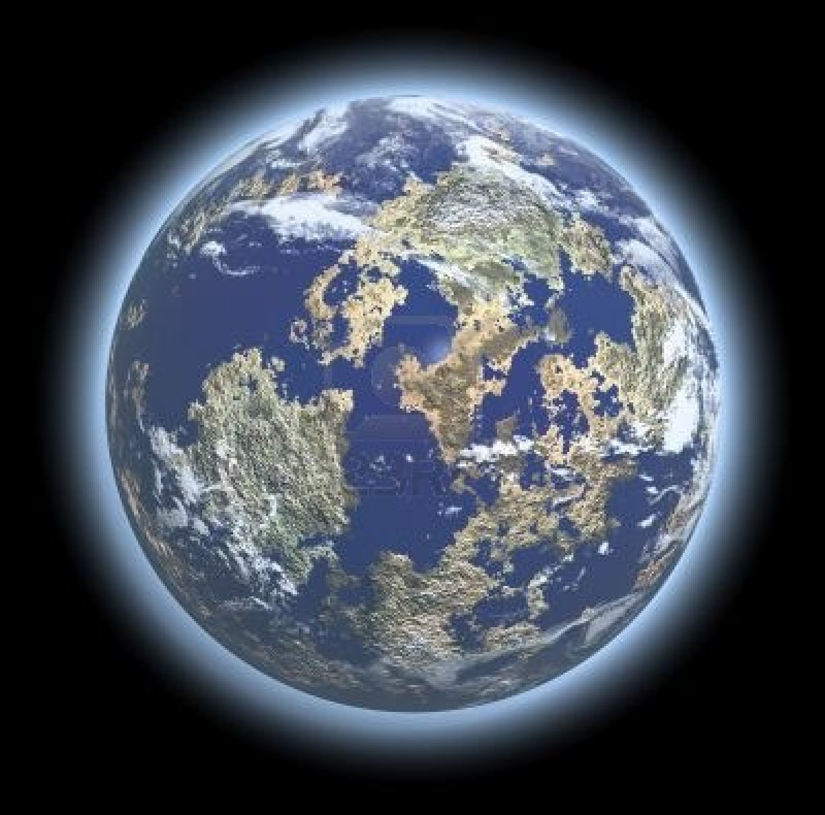
ATMOSPHERE
The gaseous envelope surrounding the earth and has five layers.
-Troposphere.
-Stratosphere.
-Mesosphere.
-Thermosphere.
-Exosphere.

Slide 4
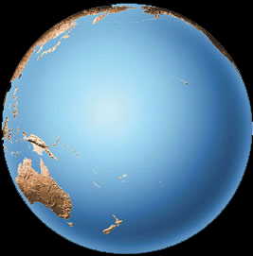
HYDROSPHERE
It is the liquid component of the earth, you can be in liquid, solid or gaseous.

Slide 5
BIOSPHERE
Is the set of all areas of the planet where there is life. It is the area where the three land subsystem are integrated and interact resulting in flows of matter and energy.

Slide 6

THANKS YOU

